Slide 1
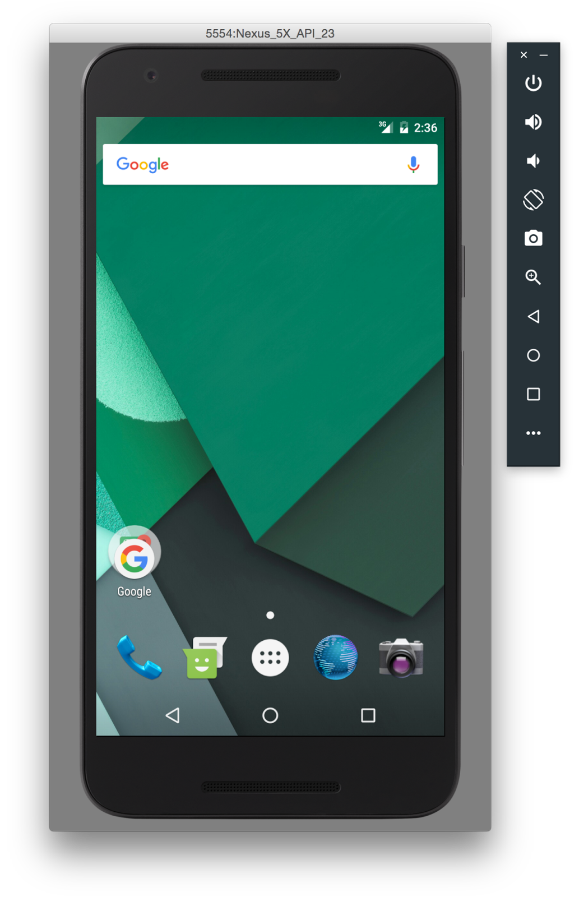
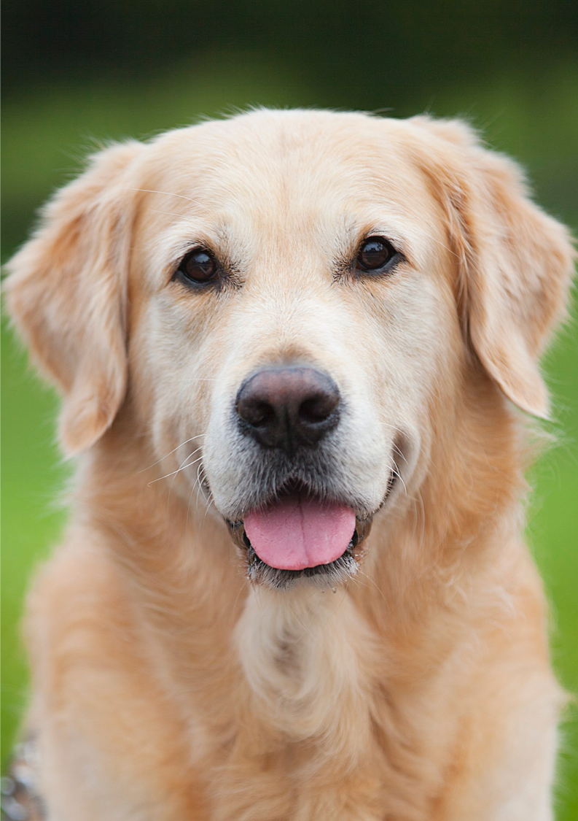


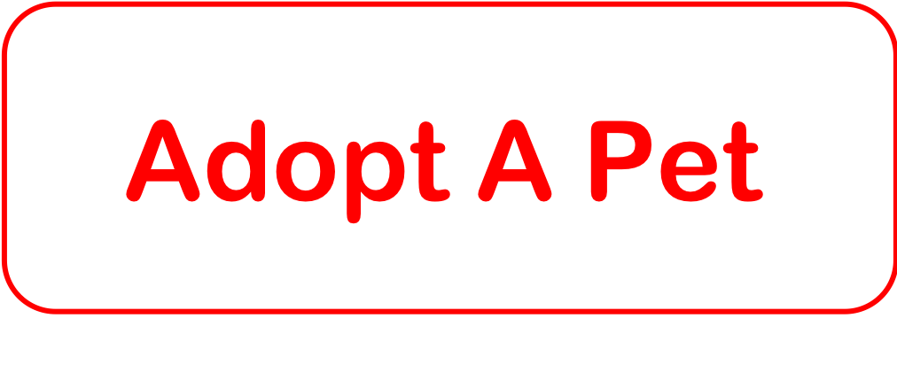


Slide 3




Slide 4



Log in

Slide 5
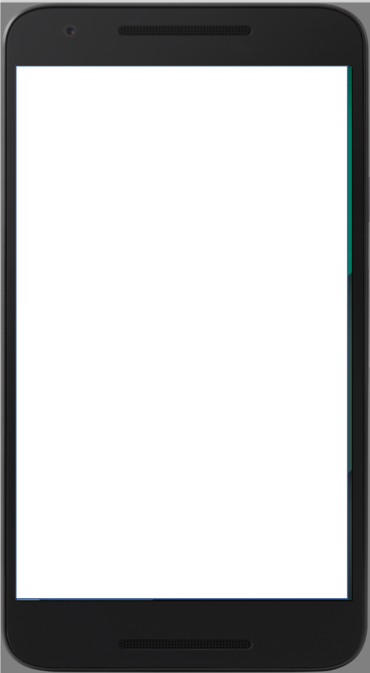

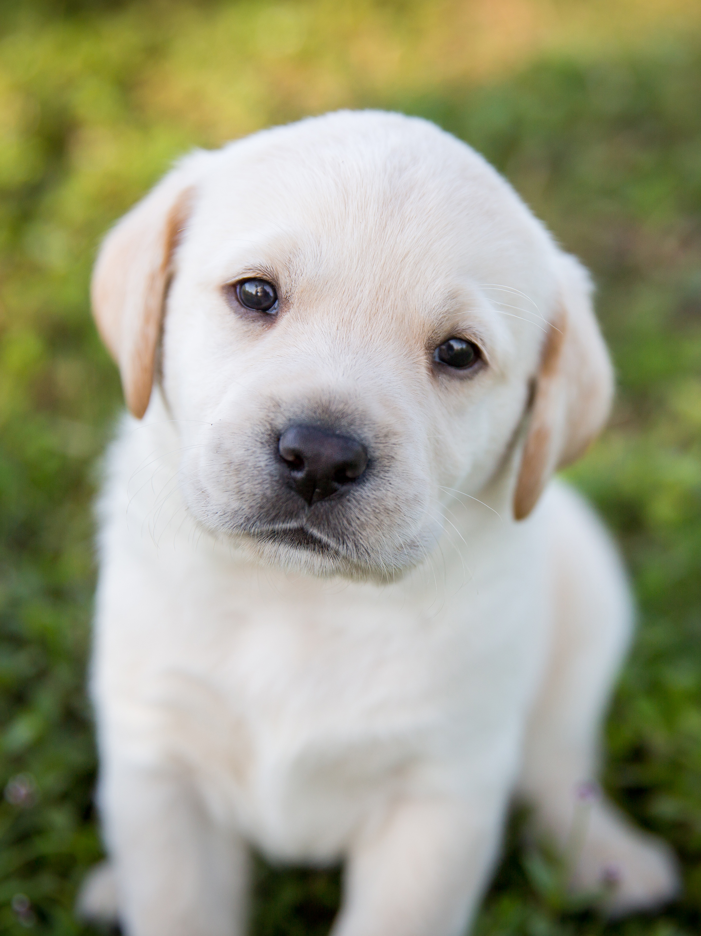
Would you like to match with your ideal pet?
Yes
No

Slide 6
Question 1:
Would you prefer a relaxed or an energetic dog?
Energetic
Calm/Relaxed
Either One

Slide 7
Your Result:
Golden Retriever
Adopt One Now

Slide 8

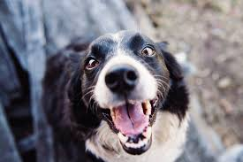

Name:
Breed: Gender:
Vander
Maltese
Male

Slide 9
Name:
Gender:
Male
Female
Breed:
Select
Energy:
House Trained:
No
Yes
Size:
Select
Image:
Upload Image
List Pet

Slide 10
Log In:
Email:
Password:
Sign in
Create Account
Email:
Password:
Create Account

Slide 11
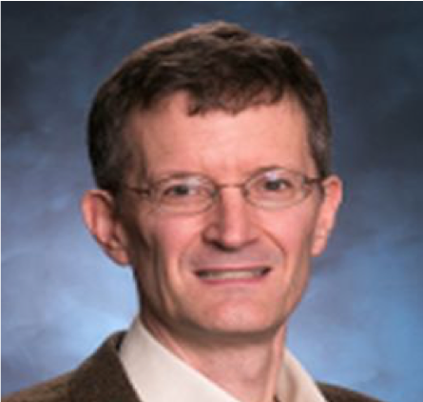
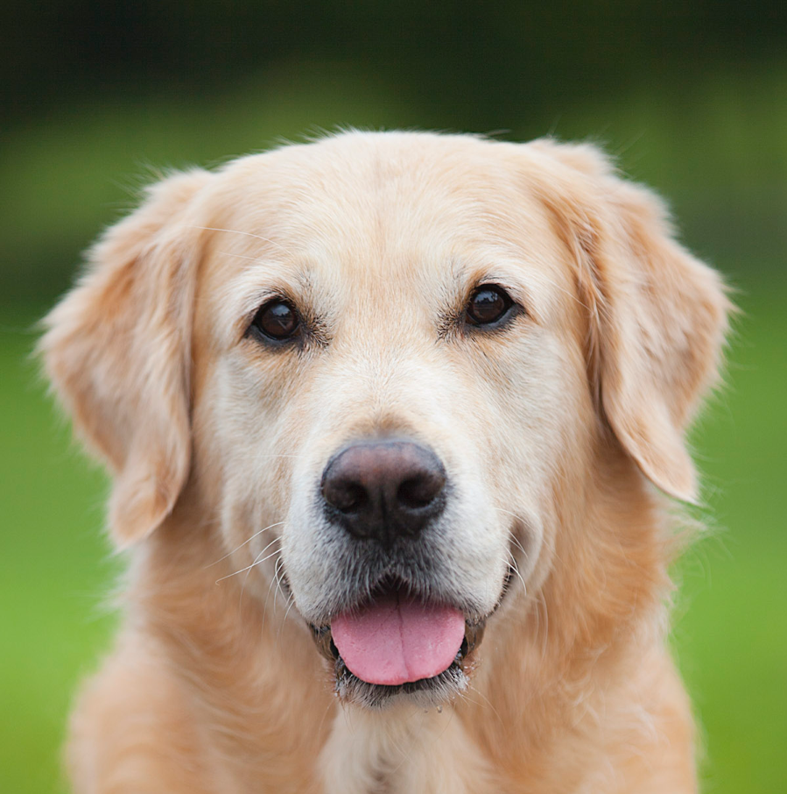
It’s a Match
You and George have liked each other
George’s Contact Info
GeorgeTheDog@gmail.com

Slide 12
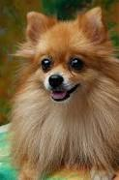
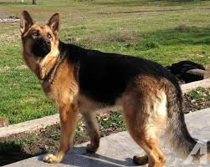
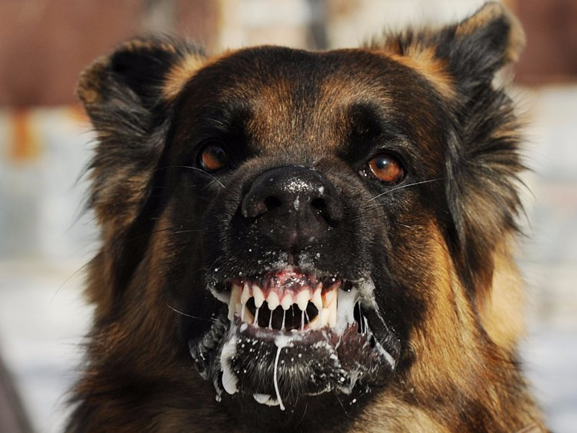
Australian Shitzu:
Loves people, loves walks, and loves you. Please Adopt.
Pomeranian:
Friendly and fluffy.
German Shepherd
Extremely Loyal
Demon Dog:
Please, I’ll pay you just take him off my hands

Slide 13

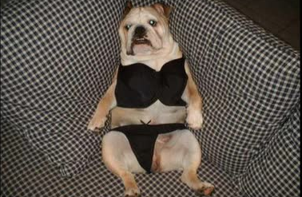
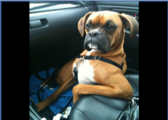
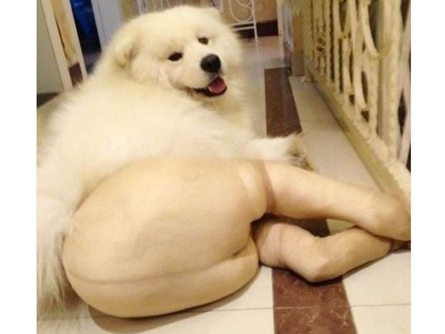
Chihuahua Male
Single and ready to mingle!
BullDog: Female
Rich men only, I’m not a beggar, I don’t need your bone!
Pitbull: Male
Buff, rich and sexy, I get whatever B**** I want.
Unknown: Female
Profile pic,
Nuff said

Slide 14
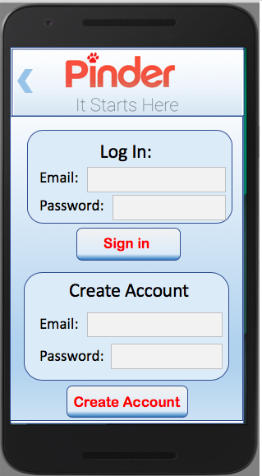
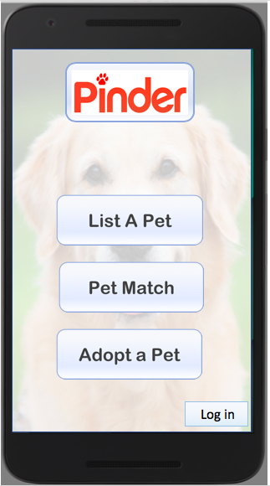
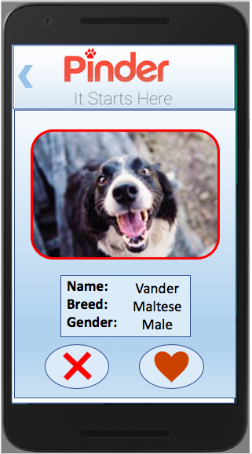
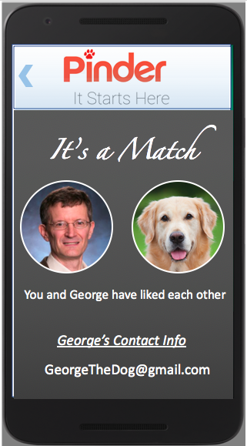
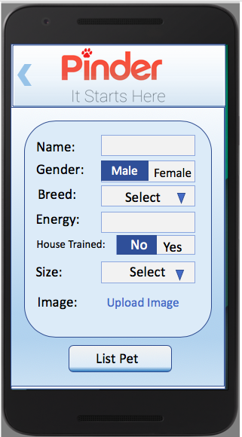
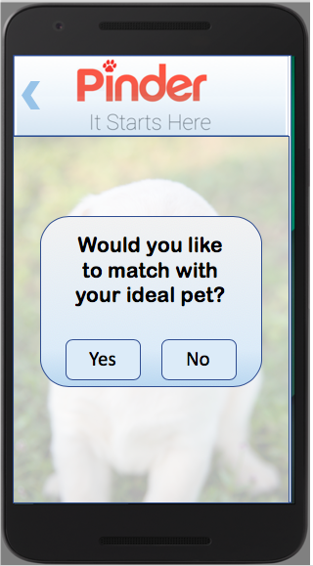
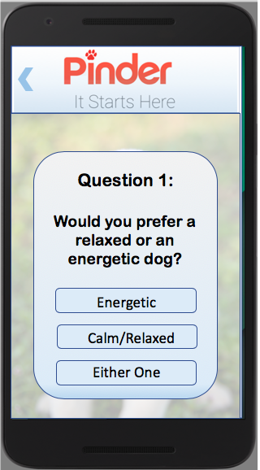
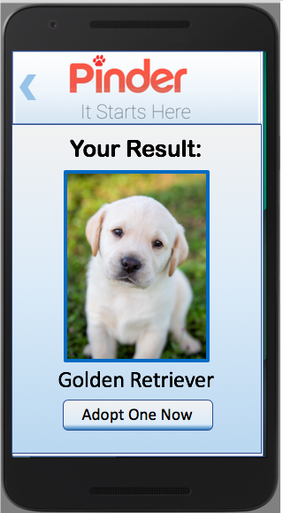

Slide 15
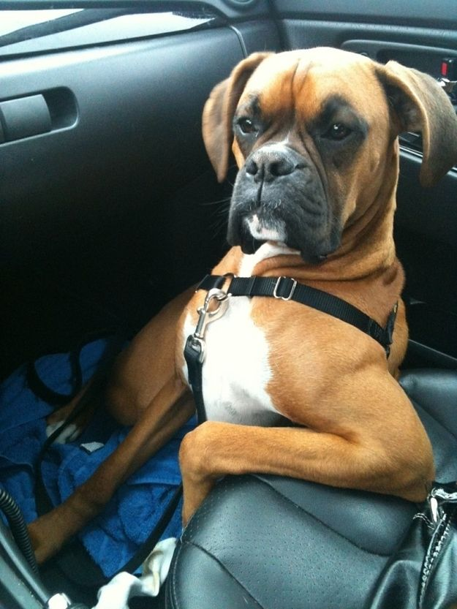

Slide 18




Slide 22
List A Pet

Slide 23
Pet Match

